Slide 1
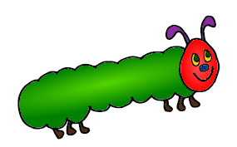
The Very Hungry Caterpillar by Eric Carle
Essential Questions
Created by Sally Vonier

Slide 2






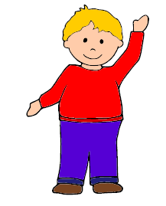

Question 1
Level 1
Who is the main character in the story?
Main
character
is
child
ladybug
caterpillar
1
1
1

Slide 3
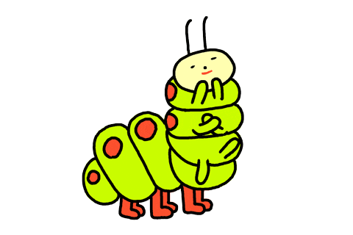


Slide 4
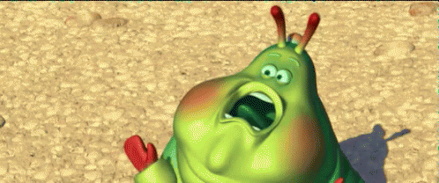


Slide 5



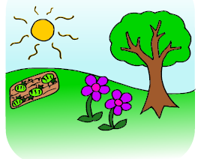
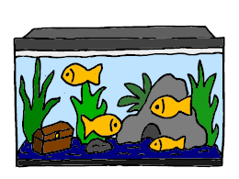
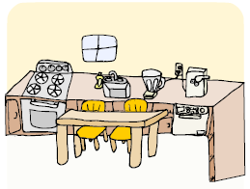
Question 2
Level 1
Setting
is
outside
aquarium
kitchen
2
2
2

Slide 8







Question 3
Level 1
Who pops out of the egg?
pops
out of egg
Chick
Caterpillar
Butterfly
3
3
3

Slide 11



Question 4
Level 1
Where is the egg?
Egg
is
on the leaf
on the flower
on the grass
4
4
4

Slide 14






Question 5
Level 1
How does the caterpillar feel at the beginning of the story?
Caterpillar
feels
sick
tired
hungry
5
5
5

Slide 17


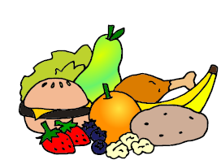

Question 6
Level 1
What is the caterpillar’s problem in the story?
Caterpillar
needed to
find
food
his mother
a butterfly
6
6
6

Slide 20

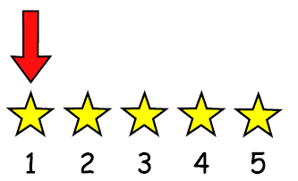


Question 7
Level 1
What does the caterpillar eat first?
Caterpillar
eats
apple
orange
leaf
7
7
7

Slide 23

Question 8
Level 1
What does the caterpillar eat last?
Caterpillar
eats
apple
orange
leaf
8
8
8

Slide 26




Question 9
Level 1
Does the caterpillar eat pizza?
9
9

Slide 29

Question 10
Level 1
Does the caterpillar eat strawberries?
10
10

Slide 32

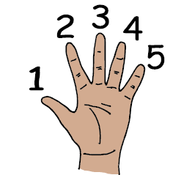

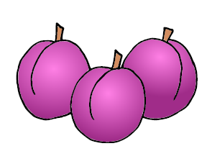

Question 11
Level 1
How many plums does the caterpillar eat?
Caterpillar
eats
5 plums
3 plums
0 plums
11
11
11

Slide 35





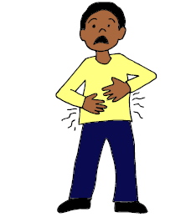
Question 12
Level 2
How does the caterpillar feel after eating so much?
Caterpillar
feels
sick
tired
hungry
12
12
12

Slide 38

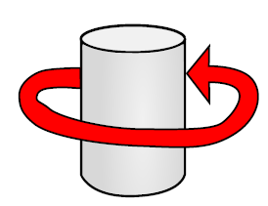


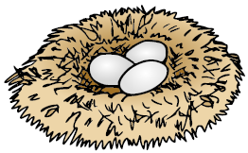
Question 13
Level 1
What does the caterpillar build around himself?
Caterpillar
builds
nest
cocoon
house
13
13
13

Slide 41
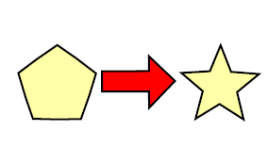

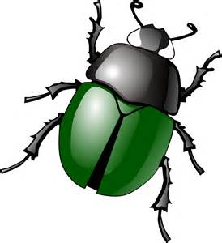
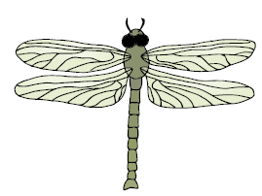
Question 14
Level 1
What does the caterpillar become?
Caterpillar
becomes
butterfly
beetle
dragonfly
14
14
14

Slide 44


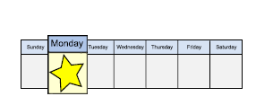
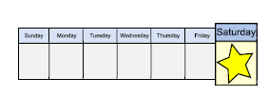

Question 15
Level 2
When does the caterpillar eat an apple?
Caterpillar
eats apple
on Monday
on Saturday
on Valentine’s
Day
15
15
15

Slide 47

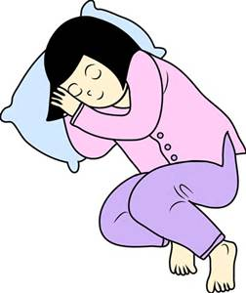


Question 16
Level 2
Why does the caterpillar build a cocoon?
Caterpillar
builds cocoon
store food
place to sleep
get out of rain
16
16
16

Slide 50

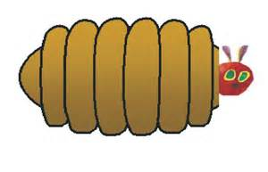
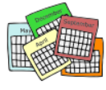
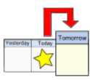
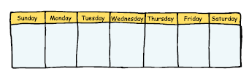
Question 17
Level 2
When does the caterpillar come out of the cocoon?
Caterpillar
comes out
after a year
after 2 weeks
tomorrow
17
17
17

Slide 53

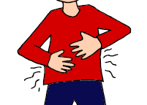





Question 18
Level 2
What foods make the caterpillar have a stomachache?
make
stomachache
Chocolate
cake
Soup
Ice cream
Lollipop
Leaf
18
18
18
18
18

Slide 56
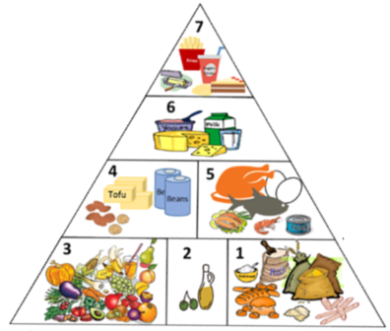




Question 19
Level 3
What type of food are apples, oranges and strawberries?
They
are
candy
vegetables
fruits
19
19

Slide 59





Question 20
Level 3
What are some other fruits?
are
fruits
Grapes
Potato
Carrots
Blueberries
Banana
20
20
20
20
20

Slide 62
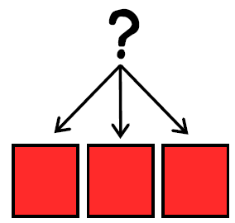
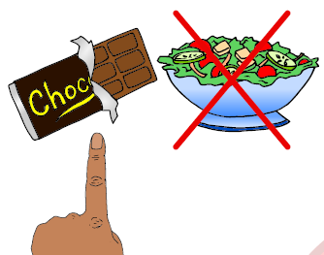


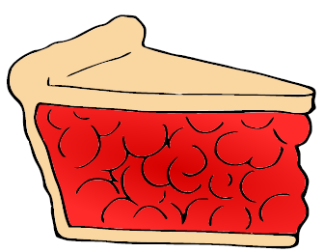
Question 21
Level 3
Which foods from the story are unhealthy?
is
unhealthy
Cake
Apple
Cupcake
Lollipop
Pie
21
21
21
21
21

Slide 65
Question 22
Level 3
What are some other unhealthy foods?
is
unhealthy

Slide 66







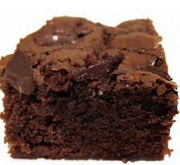


Question 22
Chips
Candy bar
Watermelon
French fries
Cookies
22
22
22
22
22
Hotdog
Salad
Brownie
Donut
Broccoli
22
22
22
22
22

Slide 70


Slide 73
Options for question book –
Copy and laminate. Fold along line located under the question on each page. The question should then line up with
the answers on the next page once folded. Select which questions you want to use. Questions are leveled for difficulty (Level 1 – knowledge/simple recall, Level 2 – comprehension/understanding and inference, Level 3 – application/applying vocabulary to real life)
These questions could be sent home for parents to use as follow-up.
To make interactive -
Copy the blank page with just the line (located as the final page) for each question page (example - if you used all
11 questions you would make 11 copies).
After laminating, put a strip of soft Velcro under the line. Cut apart answer picture for each
corresponding question, place hard Velcro square on back of each picture and place the answer options on blank
line page with Velcro strip. Answer options should follow the question they match.
You can fold on the line of the question page to reveal answer choices. Add a square of soft Velcro to the
question page that has the blank square so child can move answer to the correct location to read the AAO strip
The pages of blank colored squares can be used for you to add pictures you need for either the Agent (red),
Action (green) or Object (yellow).
You could also copy questions and answers to put into a PowerPoint to use on the Smartboard.
Pictures: Boardmaker, LessonPix, Microsoft and Google images

