Slide 1
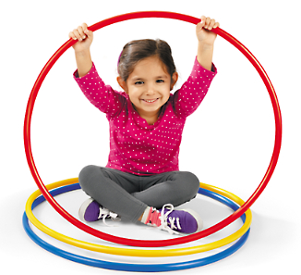
My Space Bubble

Slide 2
Let’s pretend that the hoop I am sitting in is my space ship and there is a bubble over me. This is my space bubble. My space bubble helps me and my friends feel comfortable. Most of the time when I am at school my space bubble needs to be the size of my hula hoop.

Slide 3
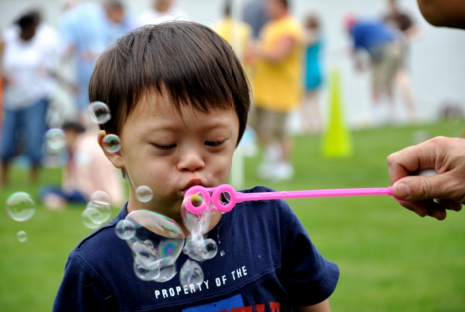
See the bubbles this boy is blowing? They are not all the same size.
Sometimes my space bubble is not the same size.
Sometimes it is small…

Slide 4
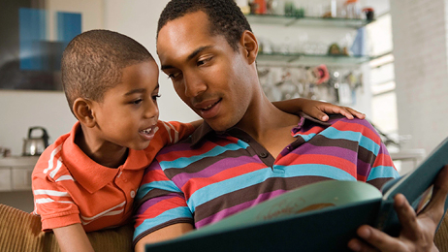
Like when I am with my family.

Slide 5
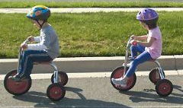
Sometimes it is big like when I need to ride a bike

Slide 6
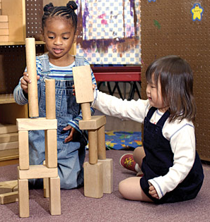
Or when I need to build a big tower with blocks. If I need more space for my space bubble I can say, “Space, please.”

Slide 7
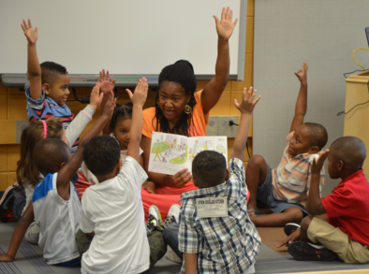
Some people need bigger space bubbles than other people. My friend needs a bigger bubble to sit in at circle than I do. I always make sure my friend gets more space for his bubble.

Slide 8
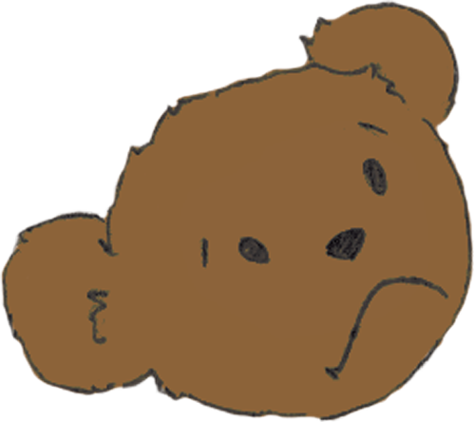
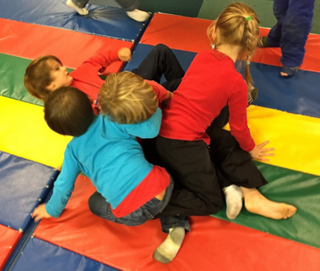
If I get out of my space bubble and get too close to my friend’s I can break their space bubble. I can be a space invader. My friends and teachers get uncomfortable and unhappy when their space bubble is broken.

Slide 9
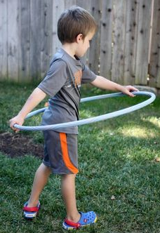
When I move around, I need to make sure I am a good space pilot. I do not crash into other friend’s space bubbles. I leave space between my friend’s bubbles and my bubble.

Slide 10
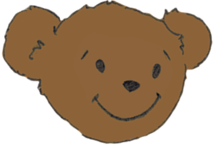
Everyone is happy when I am a good space pilot.

