Slide 1
adapted by Mayesha Bassett
The Very Hungry Caterpillar
by Eric Carle

Slide 2
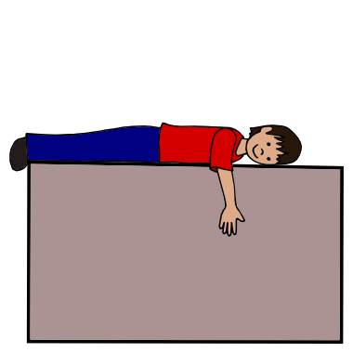
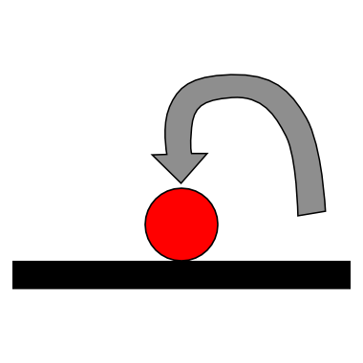
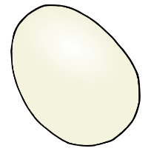
Egg
on
leaf
lay
1
1
1

Slide 3
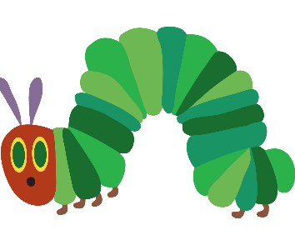
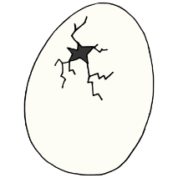
Caterpillar
came out of
egg
2
2
2

Slide 4
Caterpillar
ate
one
apple
3
3
3
3
3

Slide 5
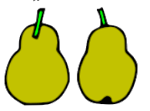
ate
two
Caterpillar
pears
4
4
4
4
4

Slide 6
Caterpillar
ate
three
plums
5
5
5
5
5

Slide 7
Caterpillar
ate
four
strawberries
6
6
6
6

Slide 8
Caterpillar
ate
five
oranges
7
7
7
7
7

Slide 9
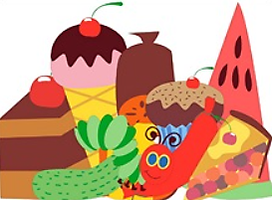
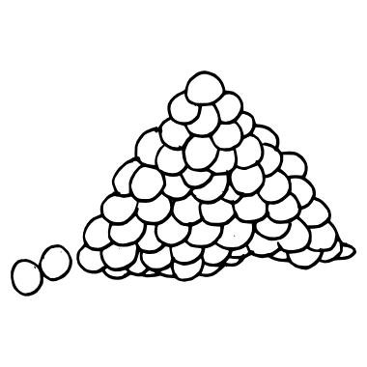
ate
foods
Caterpillar
many
8
8
8
8

Slide 10
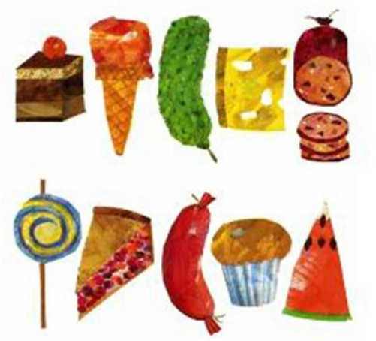
Caterpillar
ate
one
(Ask student to look
at the pictures and
name foods the
caterpillar ate)
9
9
8
8
8
8

Slide 11
9
had
stomach ache
Caterpillar
9
9
9

Slide 12
Caterpillar
ate
leaf
10
10
10

Slide 13
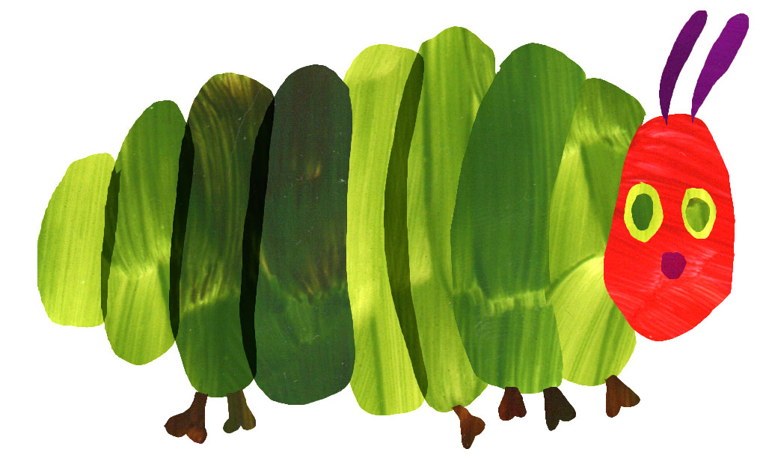
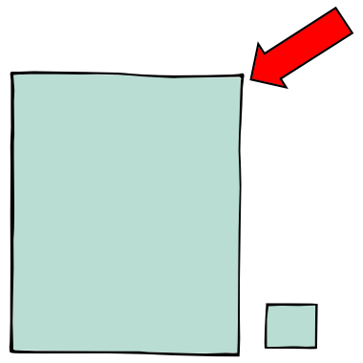
Caterpillar
is
big
11

Slide 14
makes
cocoon
Caterpillar
12
12
12
12

Slide 15
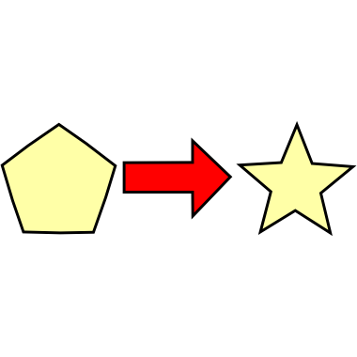
Caterpillar
turns into
butterfly
13
13
13
13

Slide 16
slice of
chocolate cake
8
ice cream cone
pickle
slice of
Swiss cheese
slice of salami
slice or
watermelon
8
8
8
8
8
8
slice of
cherry pie
sausage
lollipop
cupcake
8
8
8
8

