Slide 1
The Pout-Pout Fish By Deborah Diesen
Essential Questions
Created by Sally Vonier

Slide 2
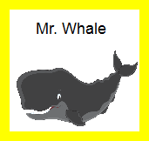
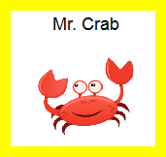
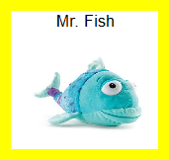
Question 1
Level 1
Who is the main character in the story?
Main
character
is
1
1
1

Slide 4
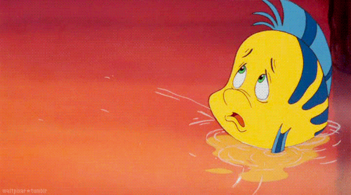

Slide 5
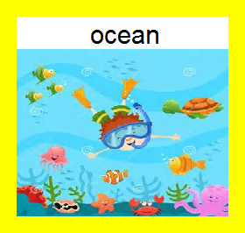
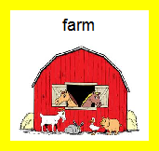
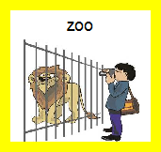
Question 2
Level 1
Setting
is
2
2
2

Slide 8
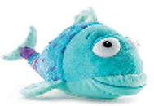
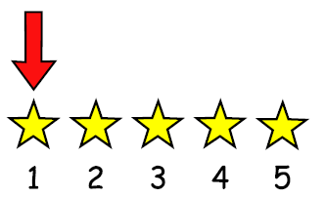
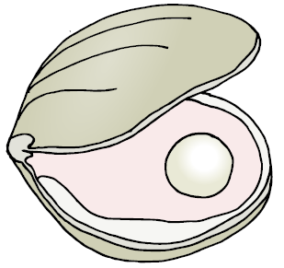
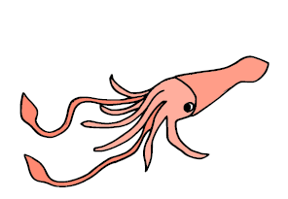
Question 3
Level 1
Who does Mr. fish see first?
Mr. Fish
saw
squid
jellyfish
clam
3
3
3

Slide 11
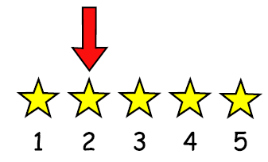
Question 4
Level 1
Who does Mr. Fish see second?
Mr. Fish
saw
squid
jellyfish
clam
4
4
4

Slide 14
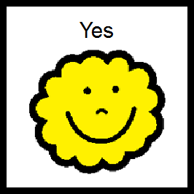
Question 5
Level 1
Did Mr. Fish see a whale?
5
5

Slide 17
Question 6
Level 1
Did Mr. Fish see an octopus?
6
6

Slide 20
Question 7
Level 2
How does Mr. Fish feel at the beginning of the story?
Mr. Fish
felt
sad
7
7
7

Slide 23
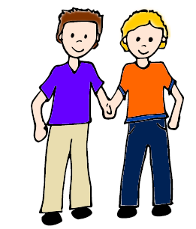
Question 8
Level 2
What were Mr. Fish’s friends trying to do?
Friends
were trying
get fish sleepy
cheer up fish
get fish to leave
8
8
8

Slide 26
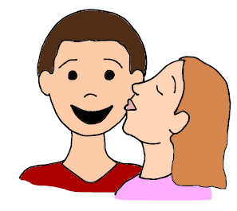
Question 9
Level 2
Why do his friends want Mr. Fish to be happy?
Mr. Fish
will stop
spreading
dreary wearies
yelling
kissing
his friends
9
9
9

Slide 29
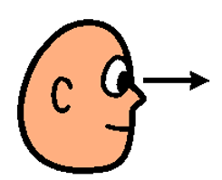
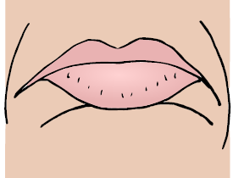
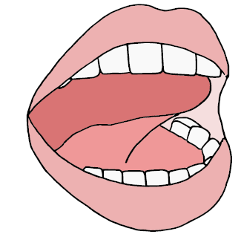
Question 10
Level 2
What does a pout look like?
Pout
is
smile
frown
open mouth
10
10
10

Slide 32
Question 11
Level 2
Who helps solve Mr. Fish’s problem?
helps
Mr. Fish
Clam
Octopus
Another fish
11
11
11

Slide 35
Question 12
Level 2
How did silver fish make Mr. Fish happy?
Silver fish
Mr. Fish
chased
kissed
gave high five
12
12
12

Slide 38
Question 13
Level 2
When does Mr. Fish feel happy?
Mr. Fish
feels happy
beginning of
story
middle of story
end of story
13
13
13

Slide 41
Question 14
Level 2
Did Mr. fish think that he could change his expression?
14
14

Slide 44
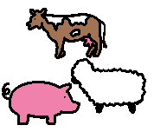
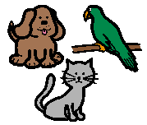
Question 15
Level 2
What kind of animals were in the story?
were
in the story
Farm animals
Pets
Ocean animals
15
15
15

Slide 47
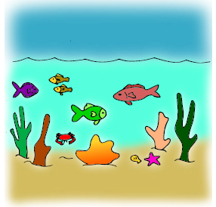
Question 16
Level 3
What are some other animals that live in the ocean?
live
in the ocean

Slide 48
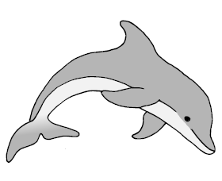
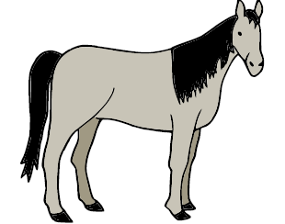
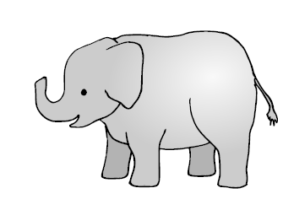
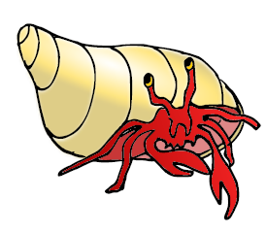
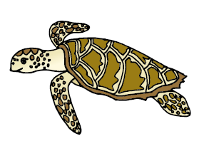
Question 16
Elephant
Sea horse
Dolphin
Horse
Shark
16
16
16
16
Bear
Crab
Whale
Turtle
16
16
16
16

Slide 51
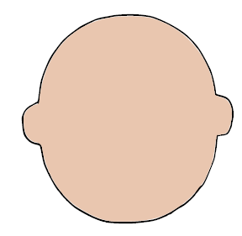
Question 17
Level 3
What expression would you wear if you were a fish? Why?
wear

Slide 52
Question 17
tired
happy
surprised
mad
17
17
17
silly
sad
excited
uncomfortable
17
17
17
17

Slide 53
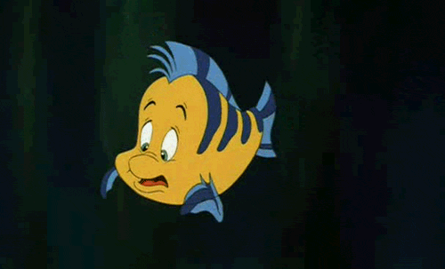

Slide 54
Question 18
Level 3
When are you sad?
gets sad

Slide 55
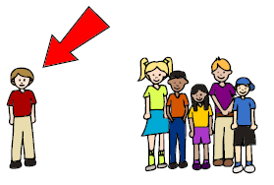
Question 18
lonely
something
breaks
yelled at
get hurt
18
18
18
18

Slide 56
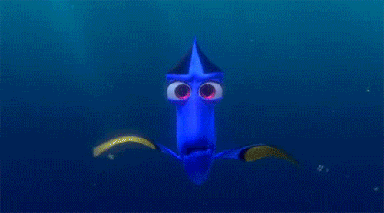

Slide 57
Question 19
Level 3
How do you cheer up a friend?
a friend

Slide 58
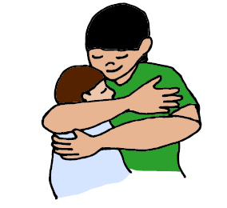
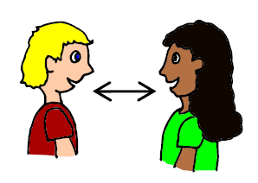
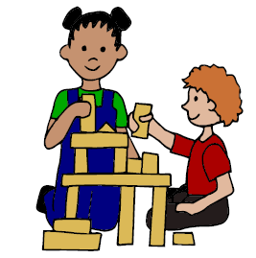
Question 19
kiss
hug
talk
play
19
19
19
19

Slide 59
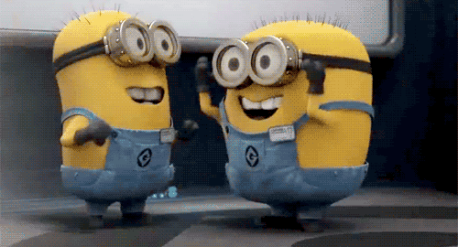

Slide 65
Options for question book –
Copy and laminate. You can fold along line located under the question on each page to hide the answers if child does not need the visual cue. Select which questions you want to use. Questions are leveled for difficulty (Level 1 – knowledge/simple recall, Level 2 – comprehension/understanding or inference, Level 3 – application/applying vocabulary to real life)
These questions could be sent home for parents to use as follow-up.
You can also pull up questions on interactive whiteboard.
To make interactive -
Copy the blank page with just the line (located as the final page) for each question page. After laminating, put a strip of soft Velcro under the line. Cut apart answer picture for each
corresponding question, place hard Velcro square on back of each picture and place the answer options on blank
line page with Velcro strip. Answer options should follow the question they match.
Add a square of soft Velcro to the question page that has the blank square so child can move answer to the correct location to read the AAO strip
The pages of blank colored squares can be used for you to add pictures you need for either the Agent (red),
Action (green) or Object (yellow).
You could also copy questions and answers to put into a PowerPoint to use on the Smartboard.
Pictures: Boardmaker, LessonPix, Microsoft images

