Slide 1
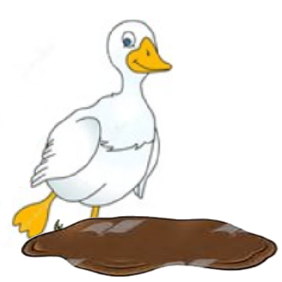
One Duck Stuck by Phyllis Root
Essential Questions

Slide 2
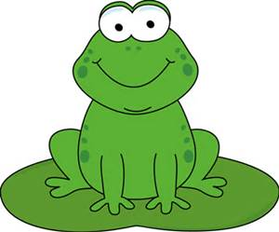
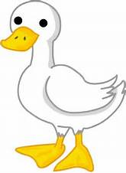
Question 1
Level 1
Who is the main character in the story?
Main
character
is
old lady
frog
duck
1
1
1

Slide 5
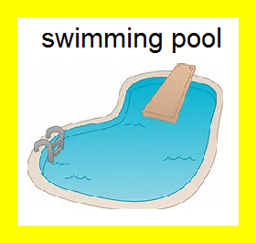
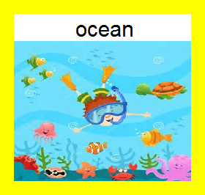
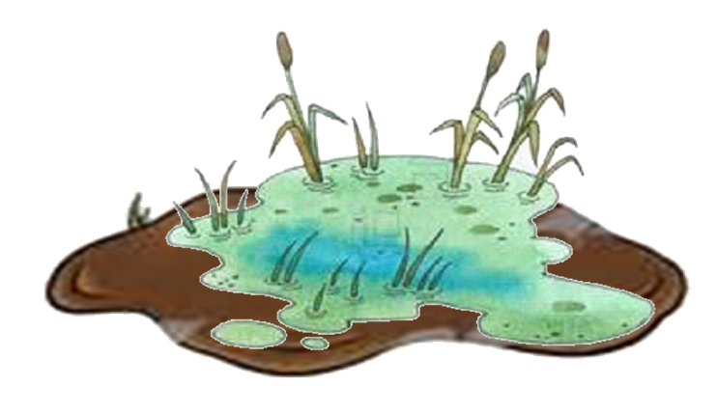
Question 2
Level 1
Setting
is
marsh
2
2
2

Slide 8
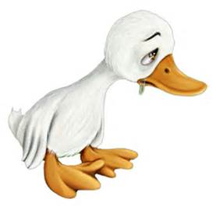
Question 3
Level 1
What was duck’s problem in the story?
Duck
was
crying
stuck in mud
lost
3
3
3

Slide 11
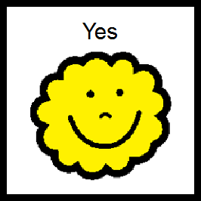
Question 4
Level 1
Does duck get unstuck?
4
4

Slide 14
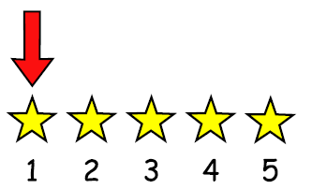
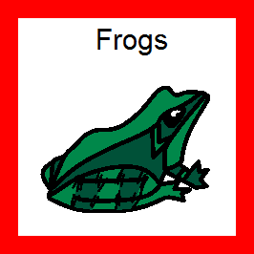
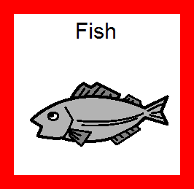
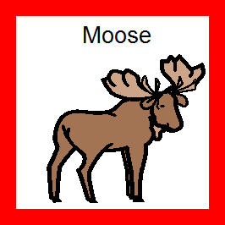
Question 5
Level 1
Who was first to help duck?
helped
first
5
5
5

Slide 17
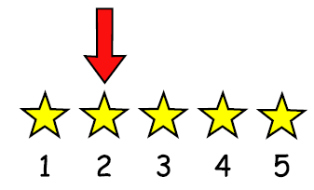
Question 6
Level 1
Who was second to help duck?
helped
second
6
6
6

Slide 20
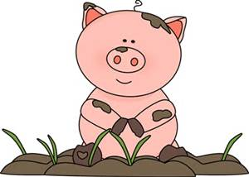
Question 7
Level 1
Is there a pig stuck in the muck in the story?
7
7

Slide 23
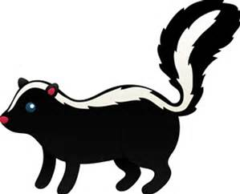
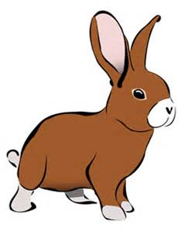
Question 8
Level 1
Who jumped to the duck?
jumped
to duck
Skunks
Rabbits
8
8
8

Slide 26
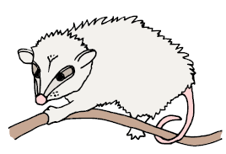
Question 9
Level 1
How did the possums move to the duck?
Possums
to duck
crawled
skipped
hopped
9
9
9

Slide 29
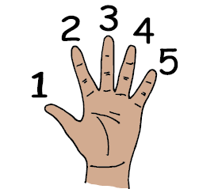
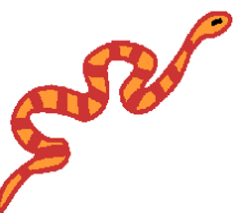
Question 10
Level 1
How many snakes helped duck?
helped
duck
1 snake
9 snakes
0 snakes
10
10
10

Slide 32
Question 11
Level 2
Who finally freed the duck?
freed
duck
Skunks
Boy
All the animals
together
11
11
11

Slide 35
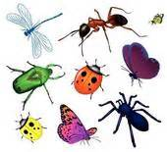
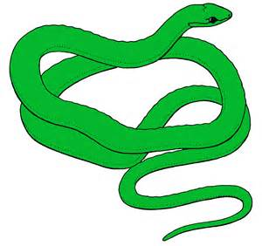
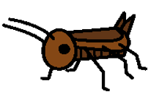
Question 12
Level 2
What insects helped duck?
helped
duck
Crickets
Snakes
Ladybugs
Dragonflies
12
12
12
12

Slide 39
Question 13
Level 2
How do you think duck felt when he was stuck?
Duck
felt
silly
worried
happy
13
13
13

Slide 42
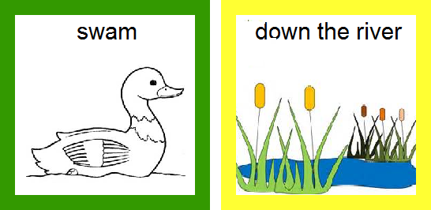
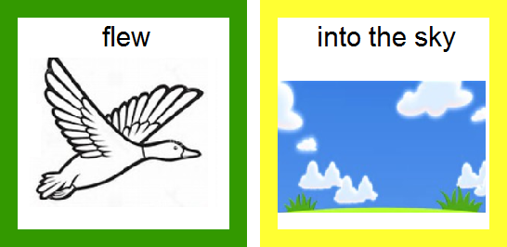
Question 14
Level 2
Where did duck go at the end of the story?
Duck
14
14

Slide 46
Question 15
Level 3
What is your favorite animal in the story? Why?
like

Slide 47
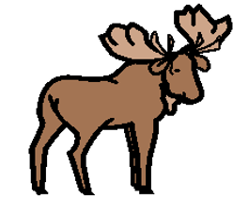
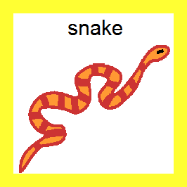
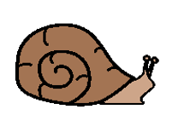
For questions 15 - 16
duck
skunk
possum
dragonfly
15 - 16
15 - 16
15 - 16
15 - 16
15 - 16
frog
fish
cricket
snail
15 - 16
15 - 16
15 - 16
15 - 16
15 - 16

Slide 49
Question 16
Level 3
Is there an animal you don’t like? Why?
don’t like

Slide 50
For questions 15 - 16
duck
skunk
possum
dragonfly
15 - 16
15 - 16
15 - 16
15 - 16
15 - 16
frog
fish
cricket
snail
15 - 16
15 - 16
15 - 16
15 - 16
15 - 16

Slide 51
Question 17
Level 3
What animals not in the story can be found at a swampy marsh?
is found
in swampy
marsh

Slide 52
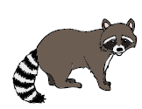
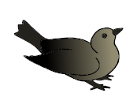
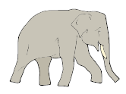
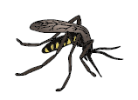
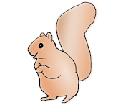
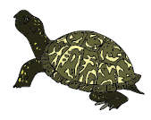
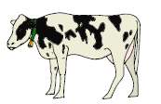
For question 17 & 18
alligator
elephant
rabbit
raccoon
bird
17 - 18
17 - 18
17 - 18
17 - 18
17 - 18
mosquito
bear
turtle
cow
squirrel
17 - 18
17 - 18
17 - 18
17 - 18
17 - 18

Slide 55
Question 18
Level 3
How would that animal move?
in the marsh

Slide 56
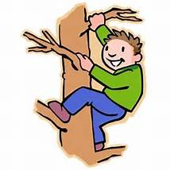
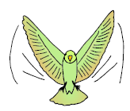
For question 18
crawl
climb
fly
swim
jump
18
18
18
18
18

Slide 59
Question 19
Level 3
How can you help your friends?
help

Slide 64
Options for question book –
Copy and laminate. You can fold along line located under the question on each page to hide the answers if child does not need the visual cue. Select which questions you want to use. Questions are leveled for difficulty (Level 1 – knowledge/simple recall, Level 2 – comprehension/understanding or inference, Level 3 – application/applying vocabulary to real life)
These questions could be sent home for parents to use as follow-up.
You can also pull up questions on interactive whiteboard.
To make interactive -
Copy the blank page with just the line (located as the final page) for each question page. After laminating, put a strip of soft Velcro under the line. Cut apart answer picture for each
corresponding question, place hard Velcro square on back of each picture and place the answer options on blank
line page with Velcro strip. Answer options should follow the question they match.
Add a square of soft Velcro to the question page that has the blank square so child can move answer to the correct location to read the AAO strip
The pages of blank colored squares can be used for you to add pictures you need for either the Agent (red),
Action (green) or Object (yellow).
You could also copy questions and answers to put into a PowerPoint to use on the Smartboard.
Pictures: Boardmaker, LessonPix, Microsoft images

