Slide 1
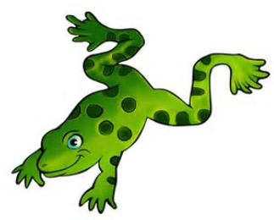
Jump Frog Jump by Robert Kalan
Essential Questions

Slide 2
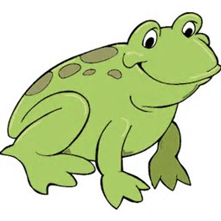
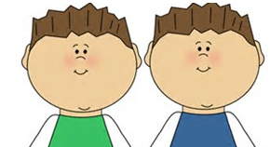
Question 1
Level 1
Who is the main character in the story?
Main
character
is
frog
fish
kids
1
1
1

Slide 4
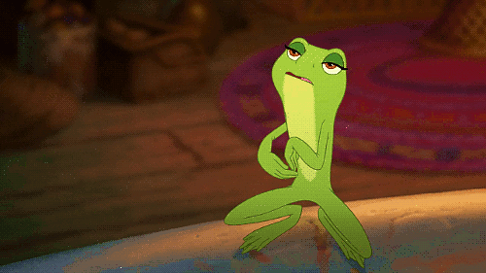

Slide 5
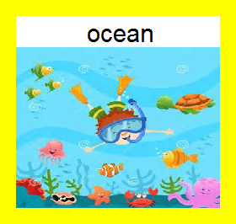
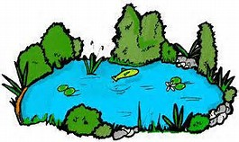
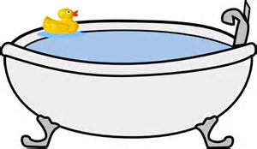
Question 2
Level 1
Setting
is
pond
bathtub
2
2

Slide 8
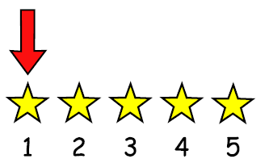
Question 3
Level 1
Who tries to catch the frog first?
tries
first
Shark
Turtle
Fish
3
3
5
3

Slide 11
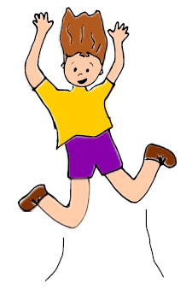
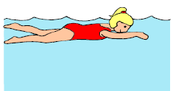
Question 4
Level 1
How does frog move?
Frog
flies
swims
jumps
4
4
4

Slide 14
Question 5
Level 1
Where does frog land when he jumps from the fish?
Frog
is on
boy
basket
log
5
5
5

Slide 17
Question 6
Level 1
Does snake catch the frog?
6
6

Slide 20
Question 7
Level 1
Where is the snake hiding?
Snake
hides
hole
branch
log
7
7
7

Slide 23
Question 8
Level 1
Who eats the snake?
eats
snake
Frog
Fish
Turtle
8
8
8

Slide 26
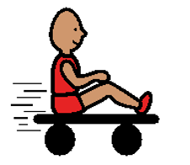
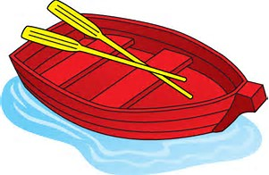
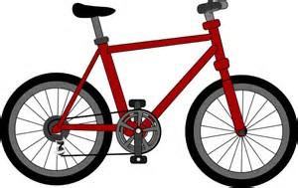
Question 9
Level 1
What are the boys riding?
Boys
ride
car
boat
bike
9
9
9

Slide 29
Question 10
Level 1
Does turtle get caught in the net?
10
10

Slide 32
Question 11
Level 1
Does frog get caught in the net?
11
11

Slide 35
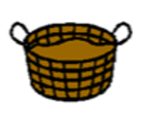
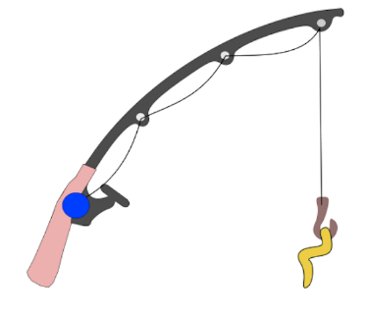
Question 12
Level 1
How do the kids catch the frog?
Kids
use
net
basket
fishing pole
12
12
12

Slide 38
Question 13
Level 1
Who helps frog escape?
helps
frog
Boy
Snake
Nobody
13
13
13

Slide 41
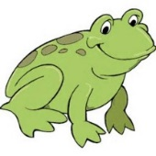
Question 14
Level 2
Why does the frog keep jumping?
Frog
jumps
to play
hide & seek
to wake up
to escape
14
14
14

Slide 44
Question 15
Level 2
How do you think the frog feels under the basket?
Frog
feels
scared
sleepy
happy
15
15
15

Slide 47
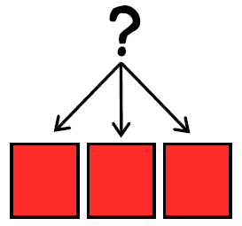
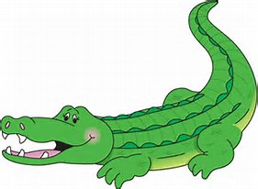
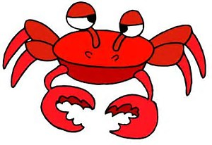
Question 16
Level 2
Which animals are not in the story?
is not
in story
Alligator
Snake
Turtle
Crab
16
16
16
16

Slide 50
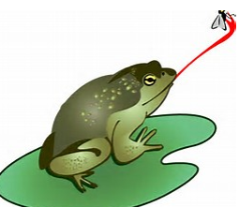
Question 17
Level 2
When does frog catch the fly?
Frog
catches fly
beginning of story
middle of
story
end of story
17
17
17

Slide 53
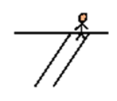
Question 18
Level 3
How would you get away if you were frog?
I
would jump
would swim
would hide
18
18
18

Slide 55
Question 19
Level 3
How would you try to catch frog?
use

Slide 56
hands
net
basket
trap
19
19
19
19
bucket
19

Slide 58
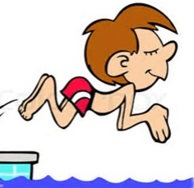
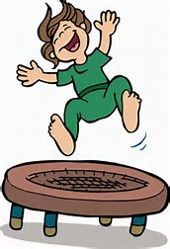
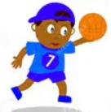
Question 20
Level 3
When do you jump?
jump
into pool
on a trampoline
with jump rope
with music
with basketball
20
20
20
20
20

Slide 60
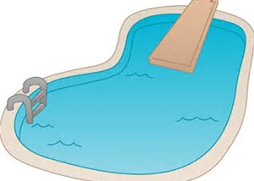
Question 21
Level 3
Where do you like to swim?
swim
pool
ocean
lake
21
21
21

Slide 66
Options for question book –
Copy and laminate. You can fold along line located under the question on each page to hide the answers if child does not need the visual cue. Select which questions you want to use. Questions are leveled for difficulty (Level 1 – knowledge/simple recall, Level 2 – comprehension/understanding or inference, Level 3 – application/applying vocabulary to real life)
These questions could be sent home for parents to use as follow-up.
You can also pull up questions on interactive whiteboard.
To make interactive -
Copy the blank page with just the line (located as the final page) for each question page. After laminating, put a strip of soft Velcro under the line. Cut apart answer picture for each
corresponding question, place hard Velcro square on back of each picture and place the answer options on blank
line page with Velcro strip. Answer options should follow the question they match.
Add a square of soft Velcro to the question page that has the blank square so child can move answer to the correct location to read the AAO strip
The pages of blank colored squares can be used for you to add pictures you need for either the Agent (red),
Action (green) or Object (yellow).
You could also copy questions and answers to put into a PowerPoint to use on the Smartboard.
Pictures: Boardmaker, LessonPix, Microsoft images

