Slide 1
I’m the Biggest Thing in the Ocean by Kevin Sherry
Essential Questions

Slide 2
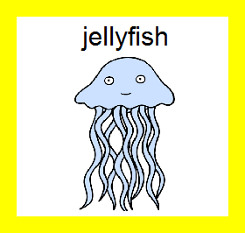
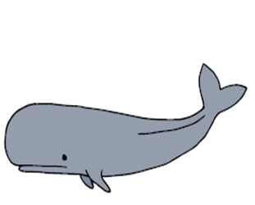
Question 1
Level 1
Who is the main character in the story?
Main
character
is
whale
squid
1
1
1

Slide 3
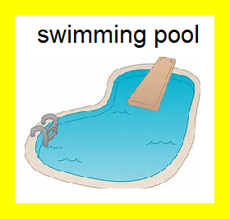
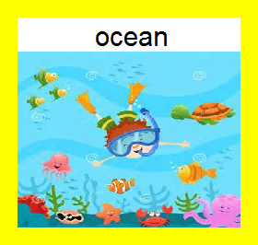
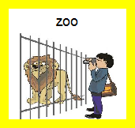
Question 2
Level 1
Setting
is
2
2
2

Slide 4
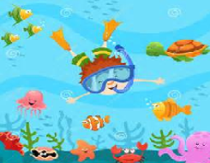
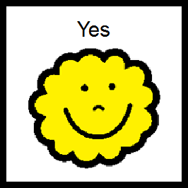
Question 3
Level 1
Was squid the biggest thing in the ocean?
3
3

Slide 5
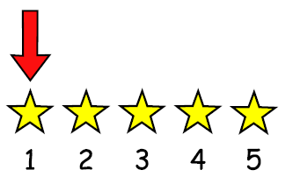
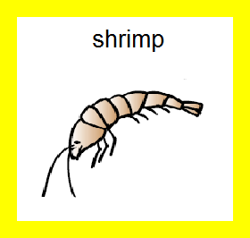
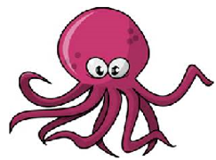
Question 4
Level 1
Who did squid see first?
Squid
saw
octopus
4
4
4

Slide 6
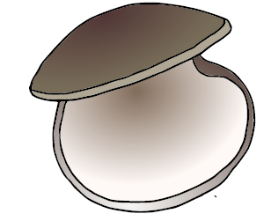
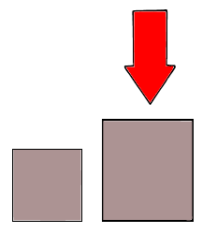
Question 5
Level 1
Who is bigger squid or clam?
is
bigger
Squid
Clam
5
5

Slide 7
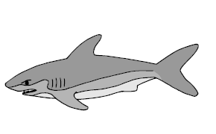
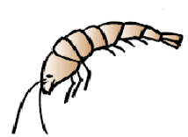
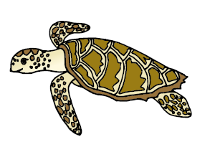
Question 6
Level 1
Who did the whale eat?
Whale
ate
only squid
many
sea animals
shark
6
6
6

Slide 8
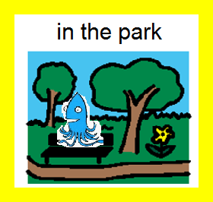
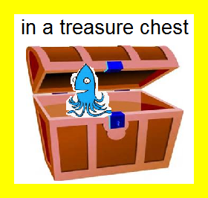
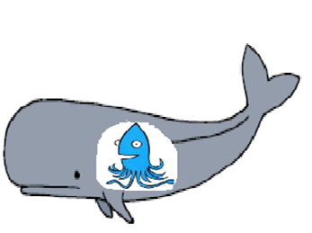
Question 7
Level 2
Where was squid at the end of the story?
Squid
was
inside the whale
7
7
7

Slide 9
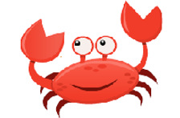
Question 8
Level 2
Who is the biggest animal in the ocean?
is
biggest
Whale
Crab
Squid
8
8
8

Slide 10
Question 9
Level 2
Why does squid think he is the biggest thing in the ocean?
Because Squid
is bigger than
whale
another squid
all the animals
he swims by
9
9
9

Slide 11
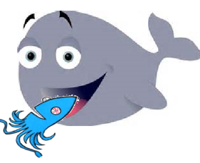
Question 10
Level 2
How does squid know that he is not the biggest thing?
Squid
is eaten
by another
squid
by a bigger
whale
by smaller
animals
10
10
10

Slide 12
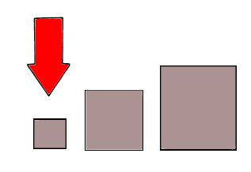
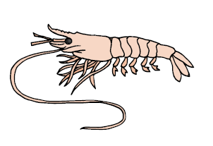
Question 11
Level 2
Who is the smallest animal in the book?
is
smallest
Whale
Shrimp
Crab
11
11
11

Slide 13
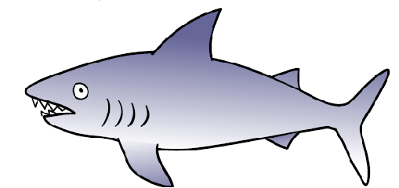
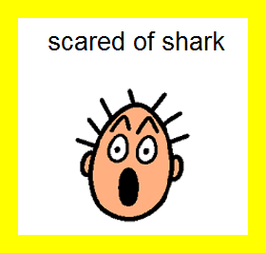
Question 12
Level 2
How do you think squid feels when he sees shark?
Squid
feels
12
12
12

Slide 14
Question 13
Level 2
When does squid think he is the biggest thing?
Squid
thinks he is
at the beginning
of the story
at the end of
the story
never
13
13
13

Slide 15
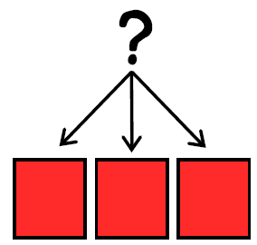
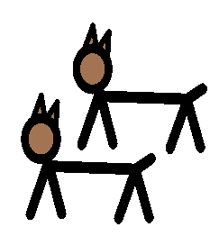
Question 14
Level 2
Which animals live in the ocean?
lives
in the ocean

Slide 16
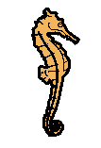
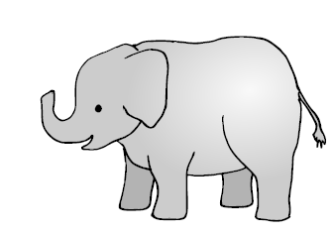
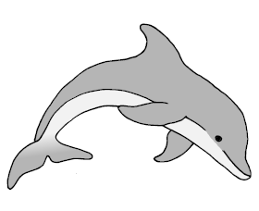
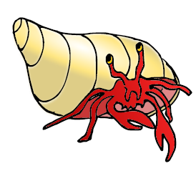
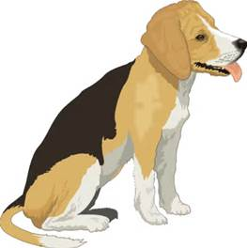
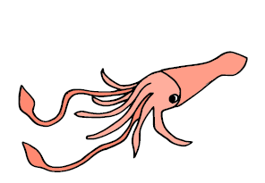
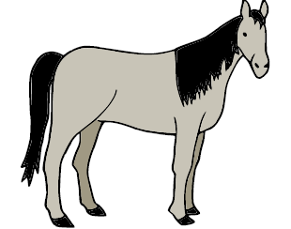
Question 14
Dolphin
Sea horse
Elephant
Crab
Dog
14
14
14
14
14
Bear
Horse
Whale
Turtle
squid
14
14
14
14
14

Slide 17
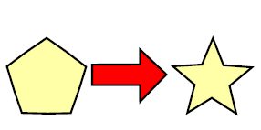
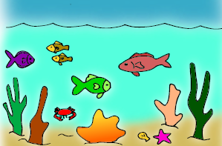
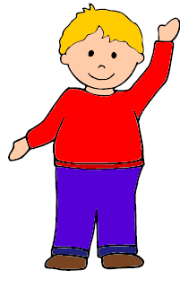
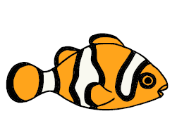
Question 15
Level 3
Which ocean animal would you be and how would you move?
swim
crawl
float
jump
wiggle
15
15
15
15
15

Slide 18
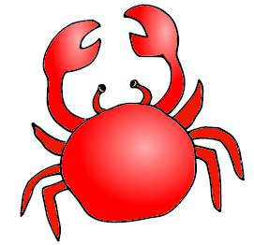
Question 15
dolphin
whale
fish
shark
15
15
15
15
shrimp
turtle
crab
squid
15
15
15
15

Slide 19
Question 16
Level 3
What are you bigger than?
is bigger

Slide 20
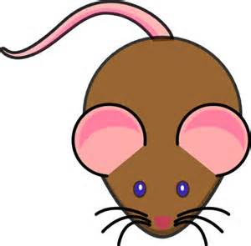
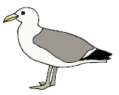
Question 16
mouse
whale
fish
teacher
16
16
16
16
shrimp
sea gull
crab
elephant
16
16
16
16

Slide 25
Options for question book –
Copy and laminate. You can fold along line located under the question on each page to hide the answers if child does not need the visual cue. Select which questions you want to use. Questions are leveled for difficulty (Level 1 – knowledge/simple recall, Level 2 – comprehension/understanding or inference, Level 3 – application/applying vocabulary to real life)
These questions could be sent home for parents to use as follow-up.
You can also pull up questions on interactive whiteboard.
To make interactive -
Copy the blank page with just the line (located as the final page) for each question page. After laminating, put a strip of soft Velcro under the line. Cut apart answer picture for each
corresponding question, place hard Velcro square on back of each picture and place the answer options on blank
line page with Velcro strip. Answer options should follow the question they match.
Add a square of soft Velcro to the question page that has the blank square so child can move answer to the correct location to read the AAO strip
The pages of blank colored squares can be used for you to add pictures you need for either the Agent (red),
Action (green) or Object (yellow).
You could also copy questions and answers to put into a PowerPoint to use on the Smartboard.
Pictures: Boardmaker, LessonPix, Microsoft and Google images

