Slide 1
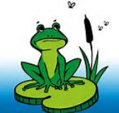
A Frog in the Bog by Karma Wilson
Essential Questions

Slide 2
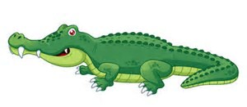
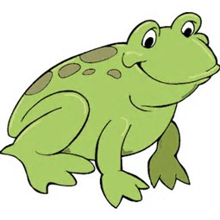
Question 1
Level 1
Who is the main character in the story?
Main
character
is
alligator
fish
frog
1
1
1

Slide 3
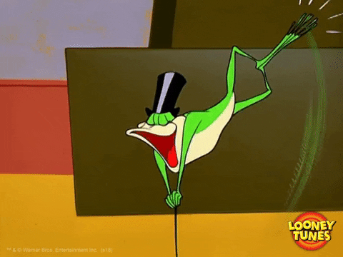

Slide 4
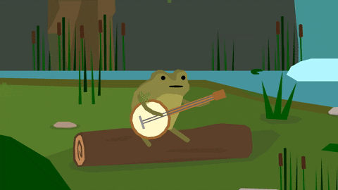

Slide 5
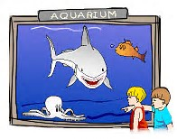
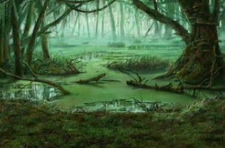
Question 2
Level 1
Setting
is
aquarium
swamp
desert
2
2

Slide 8
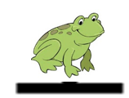
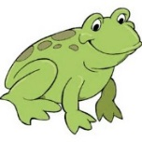
Question 3
Level 1
What does frog think he is sitting on?
Frog
thinks
it’s a log
it’s a lily pad
it’s a rock
3
3
3

Slide 11
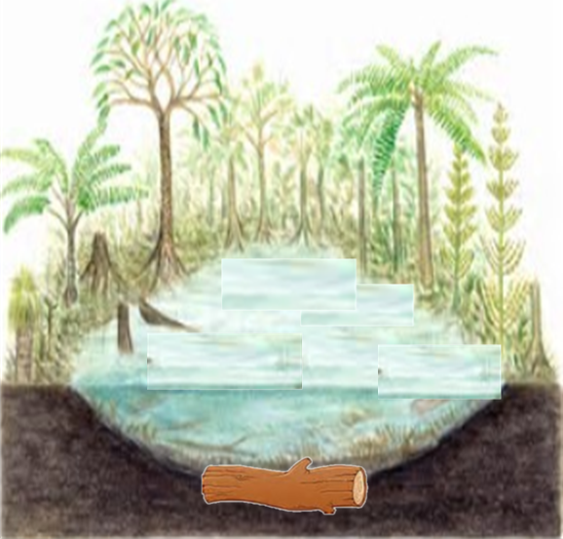
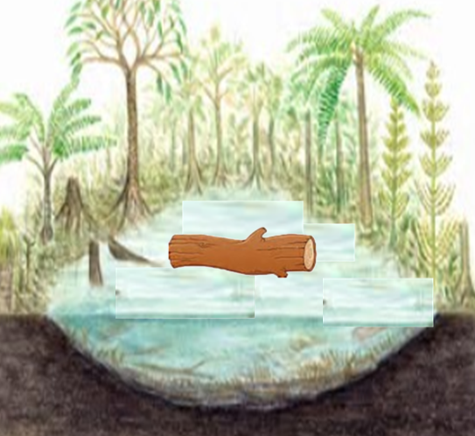
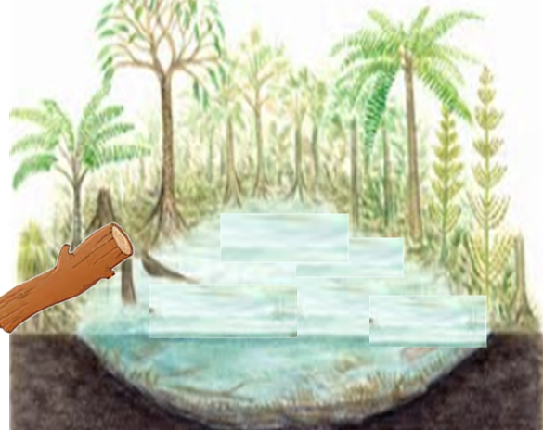
Question 4
Level 1
Where is the log?
Log
is
at the bottom
of the bog
in the middle
of the bog
on the side
of the bog
4
4
4

Slide 14
Question 5
Level 1
What size is the frog in the beginning of the story?
Frog
is
big
small
5
5

Slide 17
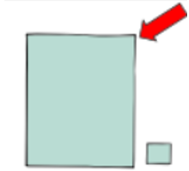
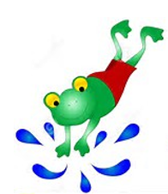
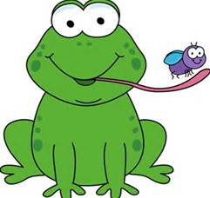
Question 6
Level 2
How does the frog get bigger?
eats
dances
swims
6
6
6

Slide 20
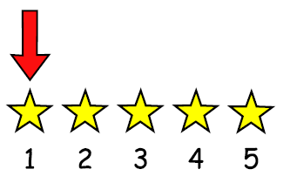
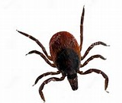
Question 7
Level 1
What does the frog eat first?
Frog
eats
tick
snail
fish
7
7
7

Slide 23
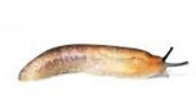
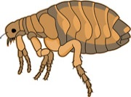
Question 8
Level 2
When does the frog eat the snails?
Frog
eats snails
first
before the fleas
after the slugs
8
8
8

Slide 26
Question 9
Level 2
How does the frog catch the tick?
Frog
uses
net
tongue
hands
9
9
9

Slide 29
Question 10
Level 1
Where does the frog see the fleas?
Fleas
are
in water
in reeds
on alligator
10
10
10

Slide 32
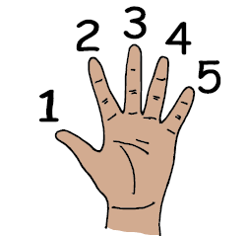
Question 11
Level 1
How many flies does the frog eat?
Frog
eats
1 fly
3 flies
6 flies
1
3
6
11
11
11

Slide 35
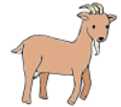
Question 12
Level 1
Who screams?
Alligator
Goat
Frog
12
12
12

Slide 38
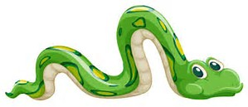
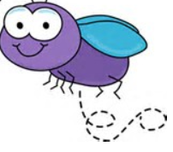
Question 13
Level 2
Why does the frog scream?
Frog
screams
because
sees gator
because
fly flew off
because
sees snake
13
13
13

Slide 41
Question 14
Level 1
Does the alligator eat the frog?
14
14

Slide 44
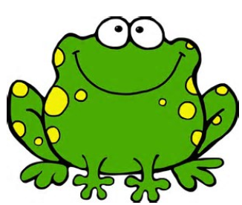
Question 15
Level 2
Why does the gator swim away?
Frog
becomes
too loud
too big
too small
15
15
15

Slide 47
Question 16
Level 2
How do you think frog feels when the gator swims away?
Frog
feels
scared
mad
relieved
16
16
16

Slide 50
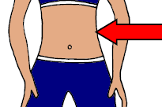
Question 17
Level 1
Do the bugs get out of the frog’s belly?
17
17

Slide 53
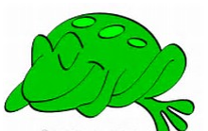
Question 18
Level 2
When do the bugs escape?
screams
eats
sleeps
18
18
18

Slide 56
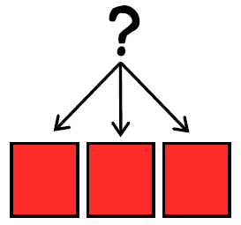
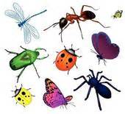
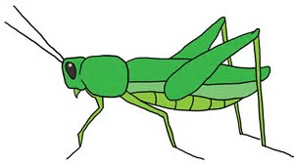
Question 19
Level 2
Which bugs are not in the story?
is not
in story
Alligator
Ladybug
Fly
Bee
Grasshopper
19
19
19
19

Slide 59
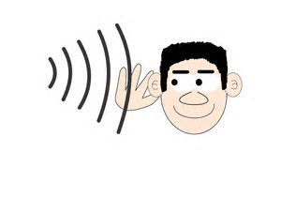
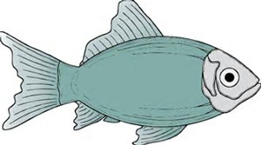
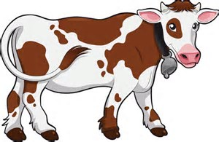
Question 20
Level 3
What rhymes with frog?
Frog
rhymes with
fish
log
cow
bog
20
20
20
20

Slide 62
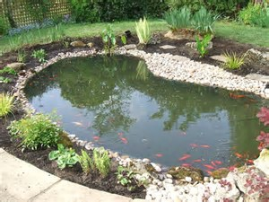
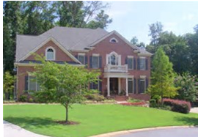
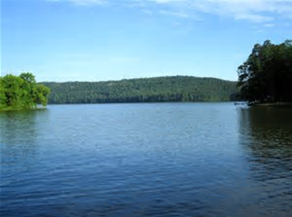
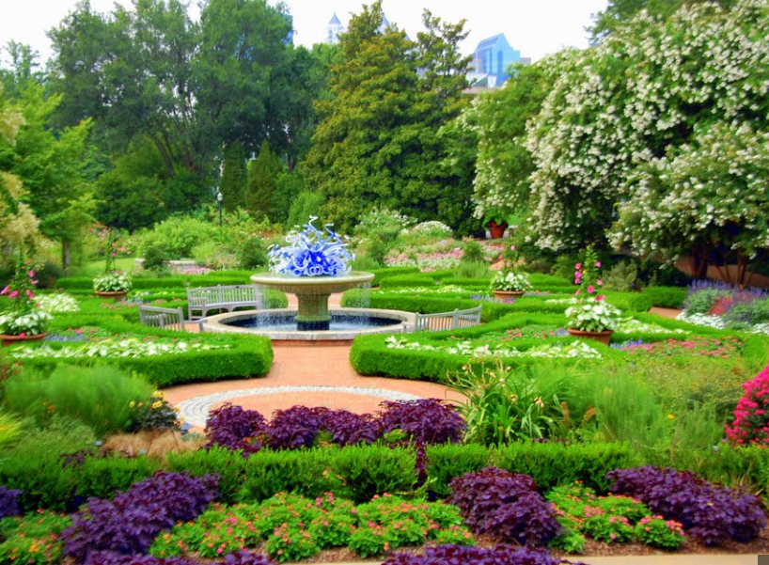
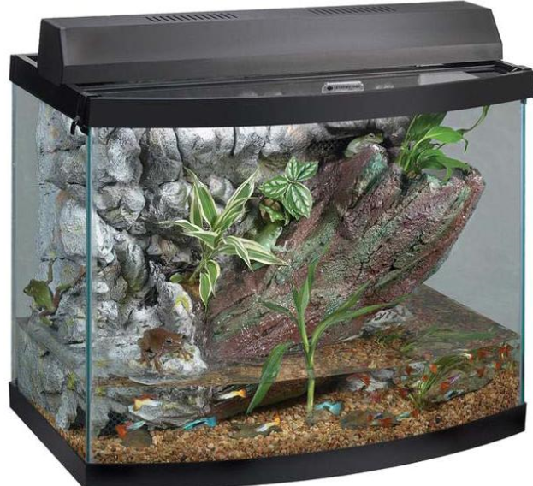
Question 21
Level 3
Where have you seen a frog?
saw frog
in pond
in yard
in lake
in garden
in aquarium
21
21
21
21
21

Slide 64
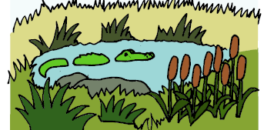
Question 22
Level 3
What other animals might live in a bog?
lives
in bog

Slide 65
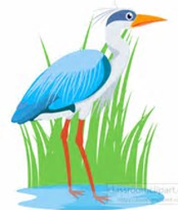
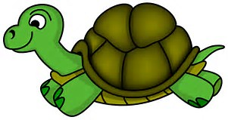
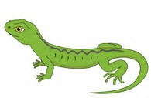
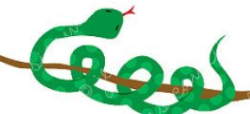
Shark
Turtle
Fish
Elephant
Bird
22
22
22
22
22
Penguin
Snake
Duck
Octopus
Lizard
22
22
22
22
22

Slide 72
Options for question book –
Copy and laminate. You can fold along line located under the question on each page to hide the answers if child does not need the visual cue. Select which questions you want to use. Questions are leveled for difficulty (Level 1 – knowledge/simple recall, Level 2 – comprehension/understanding or inference, Level 3 – application/applying vocabulary to real life)
These questions could be sent home for parents to use as follow-up.
You can also pull up questions on interactive whiteboard.
To make interactive -
Copy the blank page with just the line (located as the final page) for each question page. After laminating, put a strip of soft Velcro under the line. Cut apart answer picture for each
corresponding question, place hard Velcro square on back of each picture and place the answer options on blank
line page with Velcro strip. Answer options should follow the question they match.
Add a square of soft Velcro to the question page that has the blank square so child can move answer to the correct location to read the AAO strip
The pages of blank colored squares can be used for you to add pictures you need for either the Agent (red),
Action (green) or Object (yellow).
You could also copy questions and answers to put into a PowerPoint to use on the Smartboard.
Pictures: Boardmaker, LessonPix, Microsoft images

