Slide 1

Week 2 Digital Learning
Theme: Spring
Complete the same routine each day to maintain structure. Stand up, get your dance on, and get creative. Please feel free to reach out to me if you have any questions.

Slide 2

Morning Movement-Stand and dance
“It’s a Beautiful Day”

Slide 3


Who’s Here?
Talk about who’s at home and who’s not at home today.

Slide 4

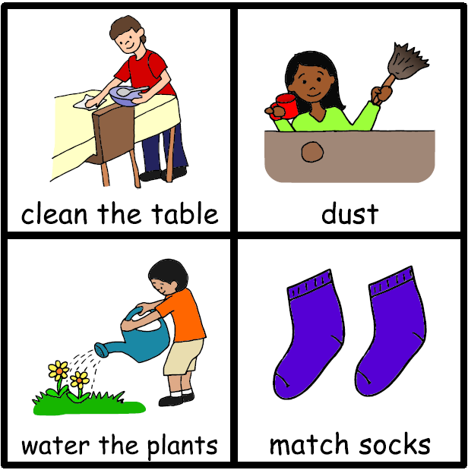


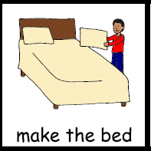
Job Chart
Give a choice between 2-4 different things to help with for the week. Have them say “I pick _____” using complete sentences.

Slide 5

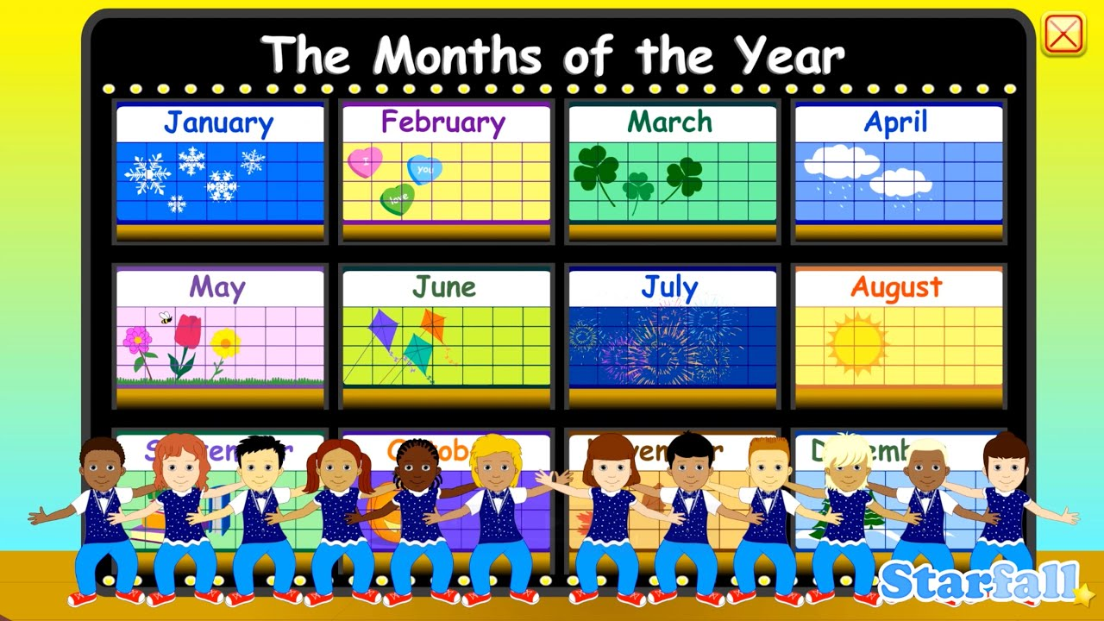
Calendar Time
Watch Months of the Year songs

Slide 6
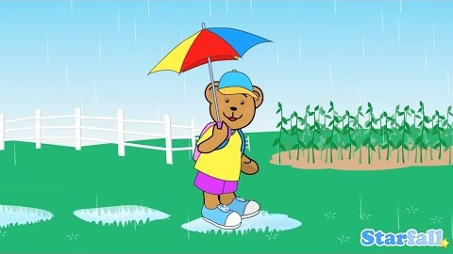
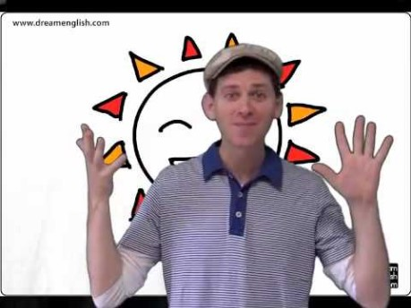
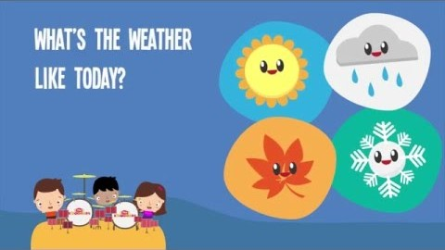

What’s the Weather?
Pick 1 then look out the window and talk about the weather and what they see outside in the sky.

Slide 7



Song Choice
Pick 1 Song for the day

Slide 8
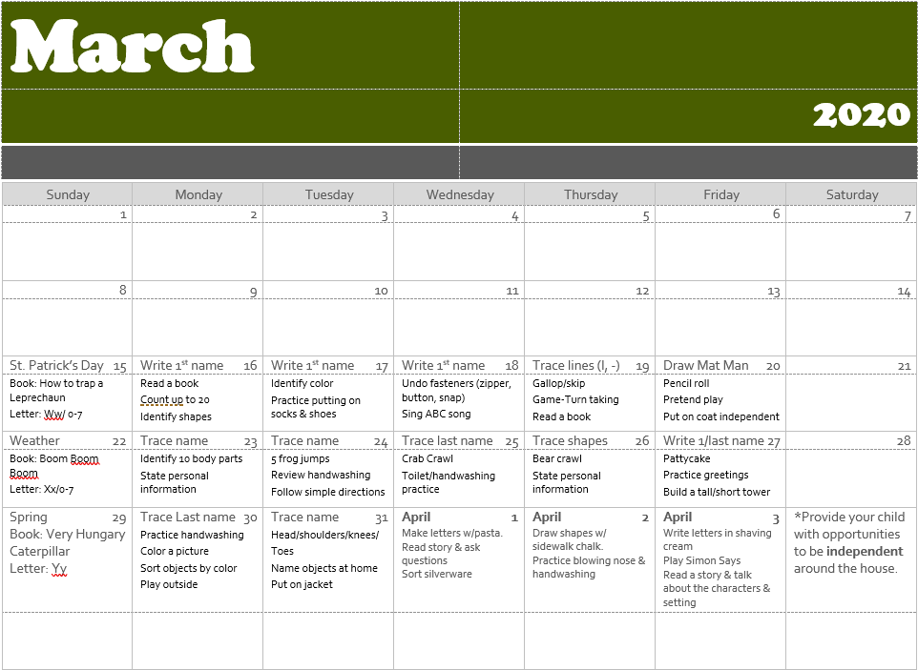
Additional Activities

