Slide 1
Adapted by Sally Vonier
Wake Up, It’s Spring
by Lisa Campbell Ernst

Slide 2
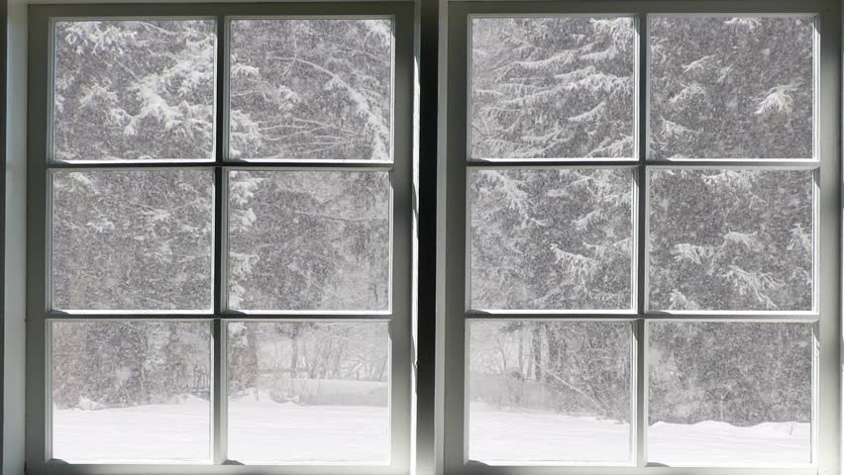
Winter
was
cold
1

Slide 3
rose
Sun
one morning
2

Slide 4
Spring is here!
3

Slide 5
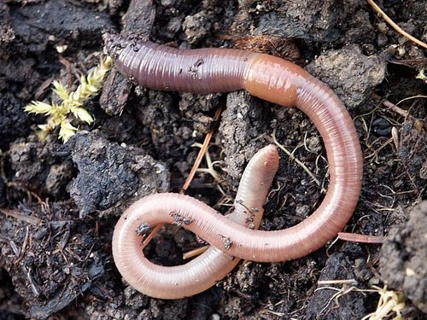
Earth
woke up
earthworm
Spring is here!
4

Slide 6
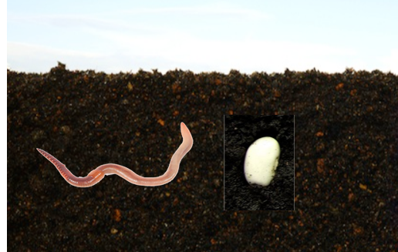
Spring is here!
5

Slide 7
Spring is here!
6

Slide 8
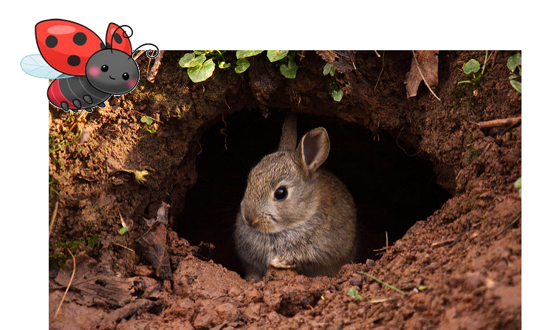
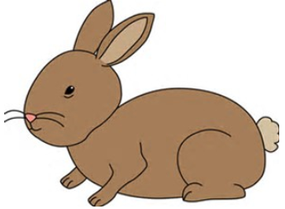
Ladybug
woke up
rabbit
Spring is here!
7

Slide 9
Rabbit
woke up
bird
Spring is here!
8

Slide 10
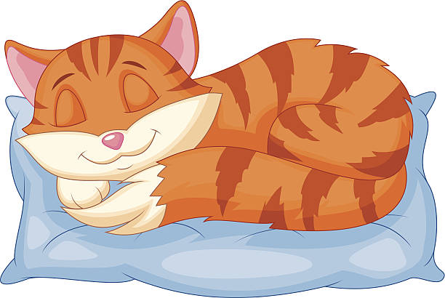
Spring is here!
9

Slide 11
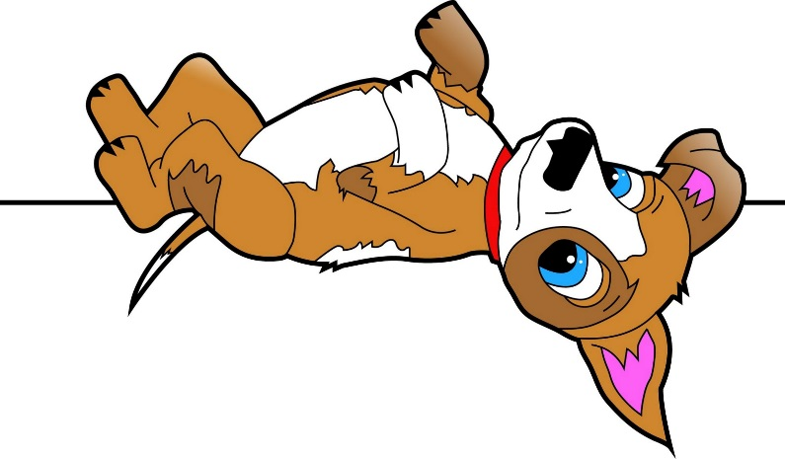
Spring is here!
10

Slide 12
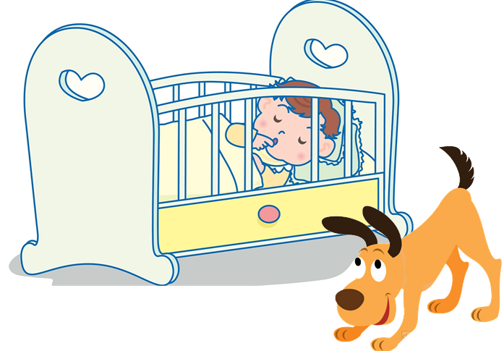
Spring is here!
11

Slide 13
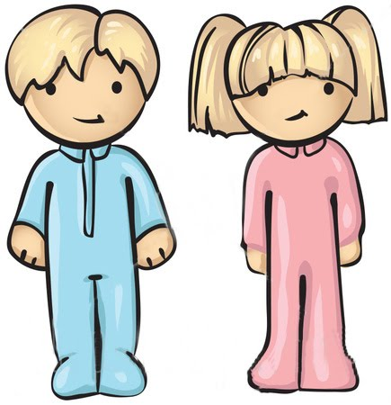
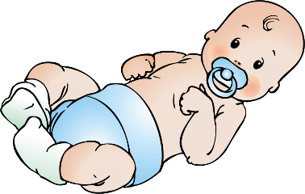
brother
and sister
Baby
woke up
Spring is here!
12

Slide 14
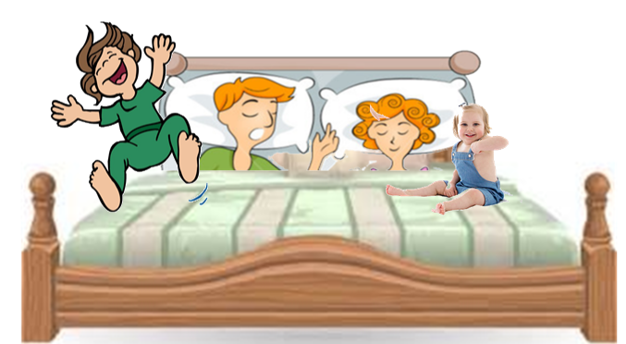
Spring is here!
13

Slide 15
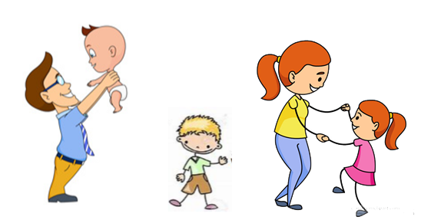
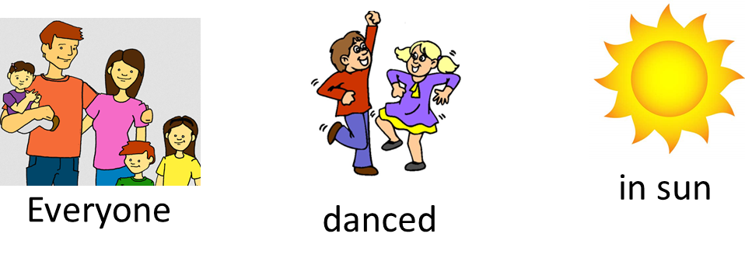
14

Slide 16
15

