Slide 1
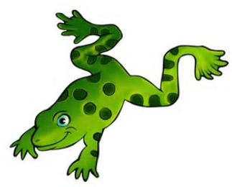
Adapted by Sally Vonier
Jump Frog Jump
by Robert Kalan

Slide 2
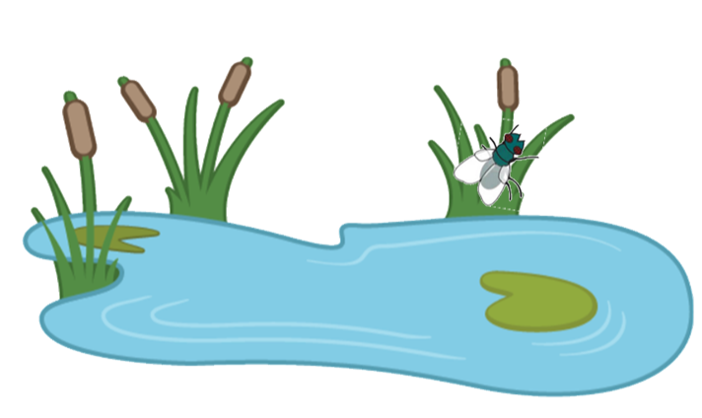
1

Slide 3
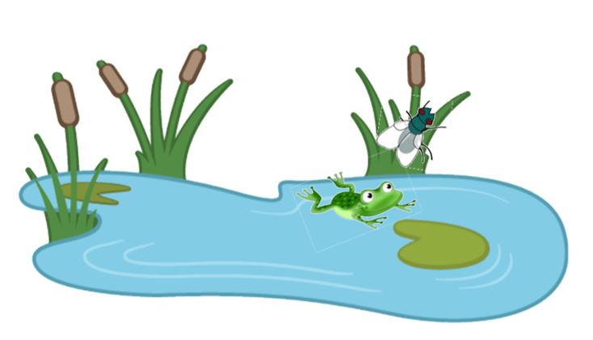
2

Slide 4
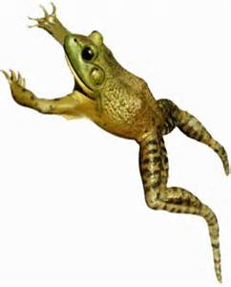
3

Slide 5
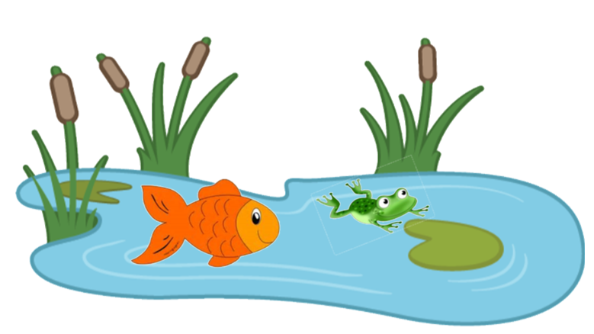
4

Slide 6
5

Slide 7
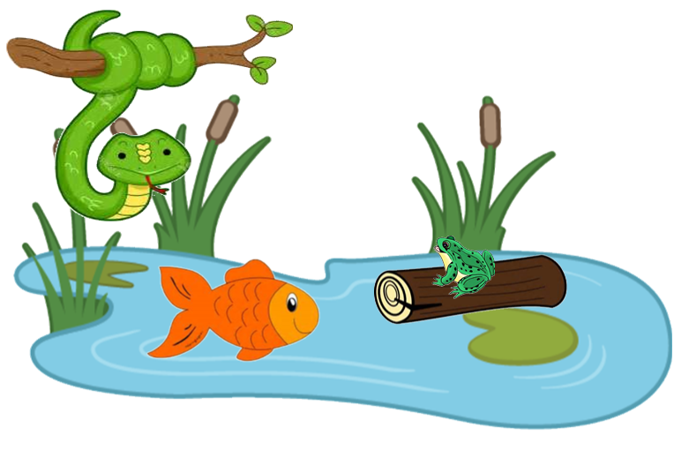
6

Slide 8
7

Slide 9
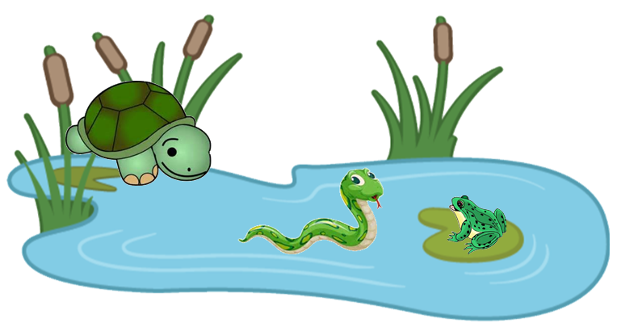
8

Slide 10
9

Slide 11
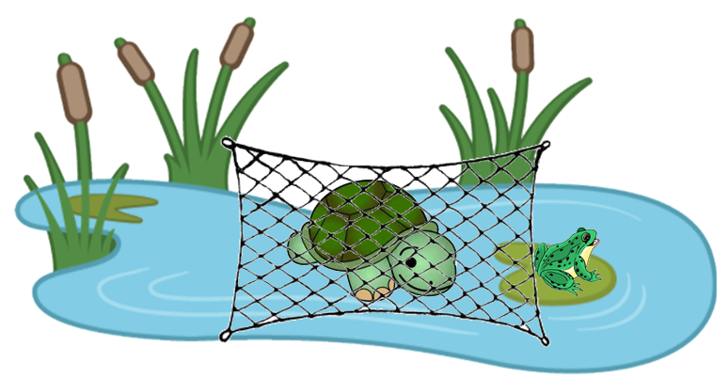
10

Slide 12
11

Slide 13
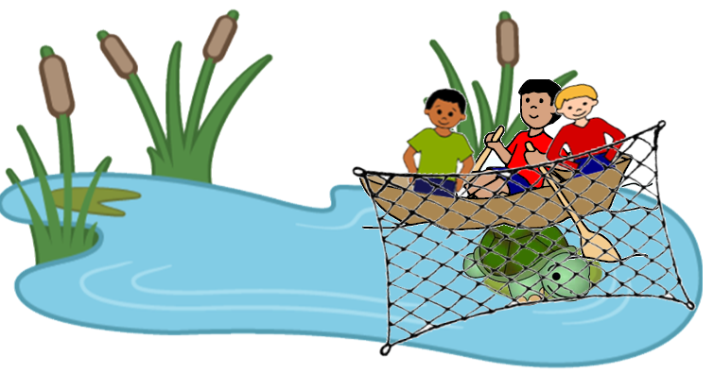
12

Slide 14
13

Slide 15
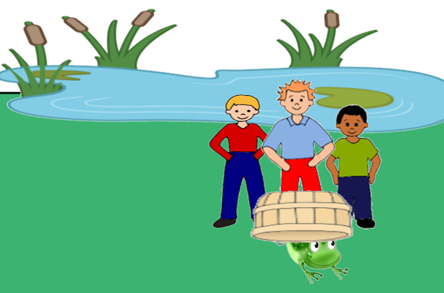
14

Slide 16
15

